Slide 1
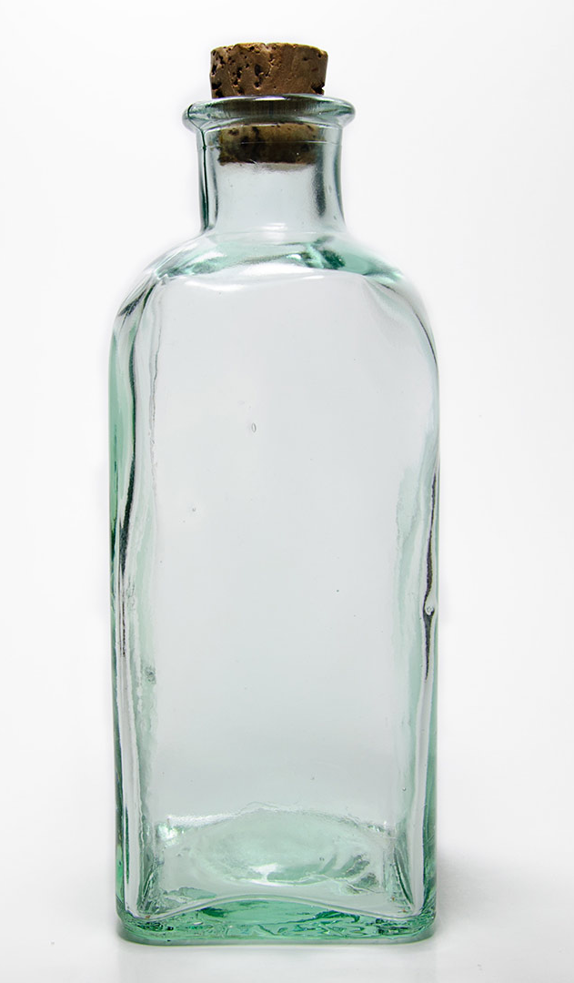
Daily Review
Describing Light Related Properties of Objects
Does the object produce light? yes = luminous no = non-luminous If no, how much light can pass through the object? none, it is reflected = opaque some, blurry image = translucent all, clear image = transparent
Describe the light related properties of a glass bottle.
The bottle is a non-luminous object. It is transparent because light can pass through and the object is clearly seen.

Slide 2
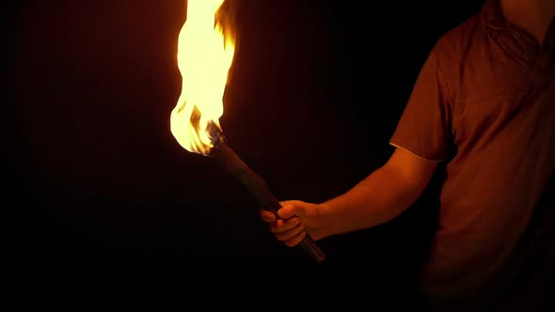
Daily Review
Describe the light related properties of a fire.
Describing Light Related Properties of Objects
Does the object produce light? yes = luminous no = non-luminous If no, how much light can pass through the object? none, it is reflected = opaque some, blurry image = translucent all, clear image = transparent
A fire produces light, so it is a luminous object.

Slide 3
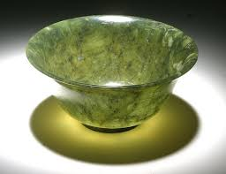
Daily Review
Describing Light Related Properties of Objects
Does the object produce light? yes = luminous no = non-luminous If no, how much light can pass through the object? none, it is reflected = opaque some, blurry image = translucent all, clear image = transparent
Describe the light related properties of the bowl.
The bowl is a non-luminous object. It is translucent because it allows some light to pass through.

Slide 4
Reflection of Light Year 9 Physics

Slide 5

Learning Objectives
CFU
What are we going to learn?
Describe the difference between diffuse and regular reflection.
Describe and apply the law of reflection.
Activate Prior Knowledge
Light can be reflected by different objects to produce a clear image.
Think, pair, share: Describe a situation where you can see a clear image or reflection in an object.

Slide 6
Concept Development
CFU 1
What happens to light that falls on a non-luminous object?
Reflection of Light
Non-luminous objects do not produce their own light.
Light falling on these objects either passes through the object or is reflected and bounces off the object.
Light reflecting off non-luminous objects can be diffuse reflection or regular reflection.
CFU 2
What are the two types of reflection?

Slide 7

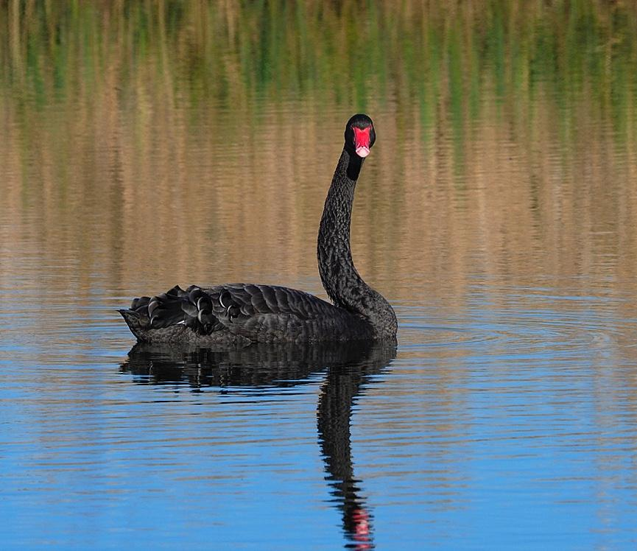
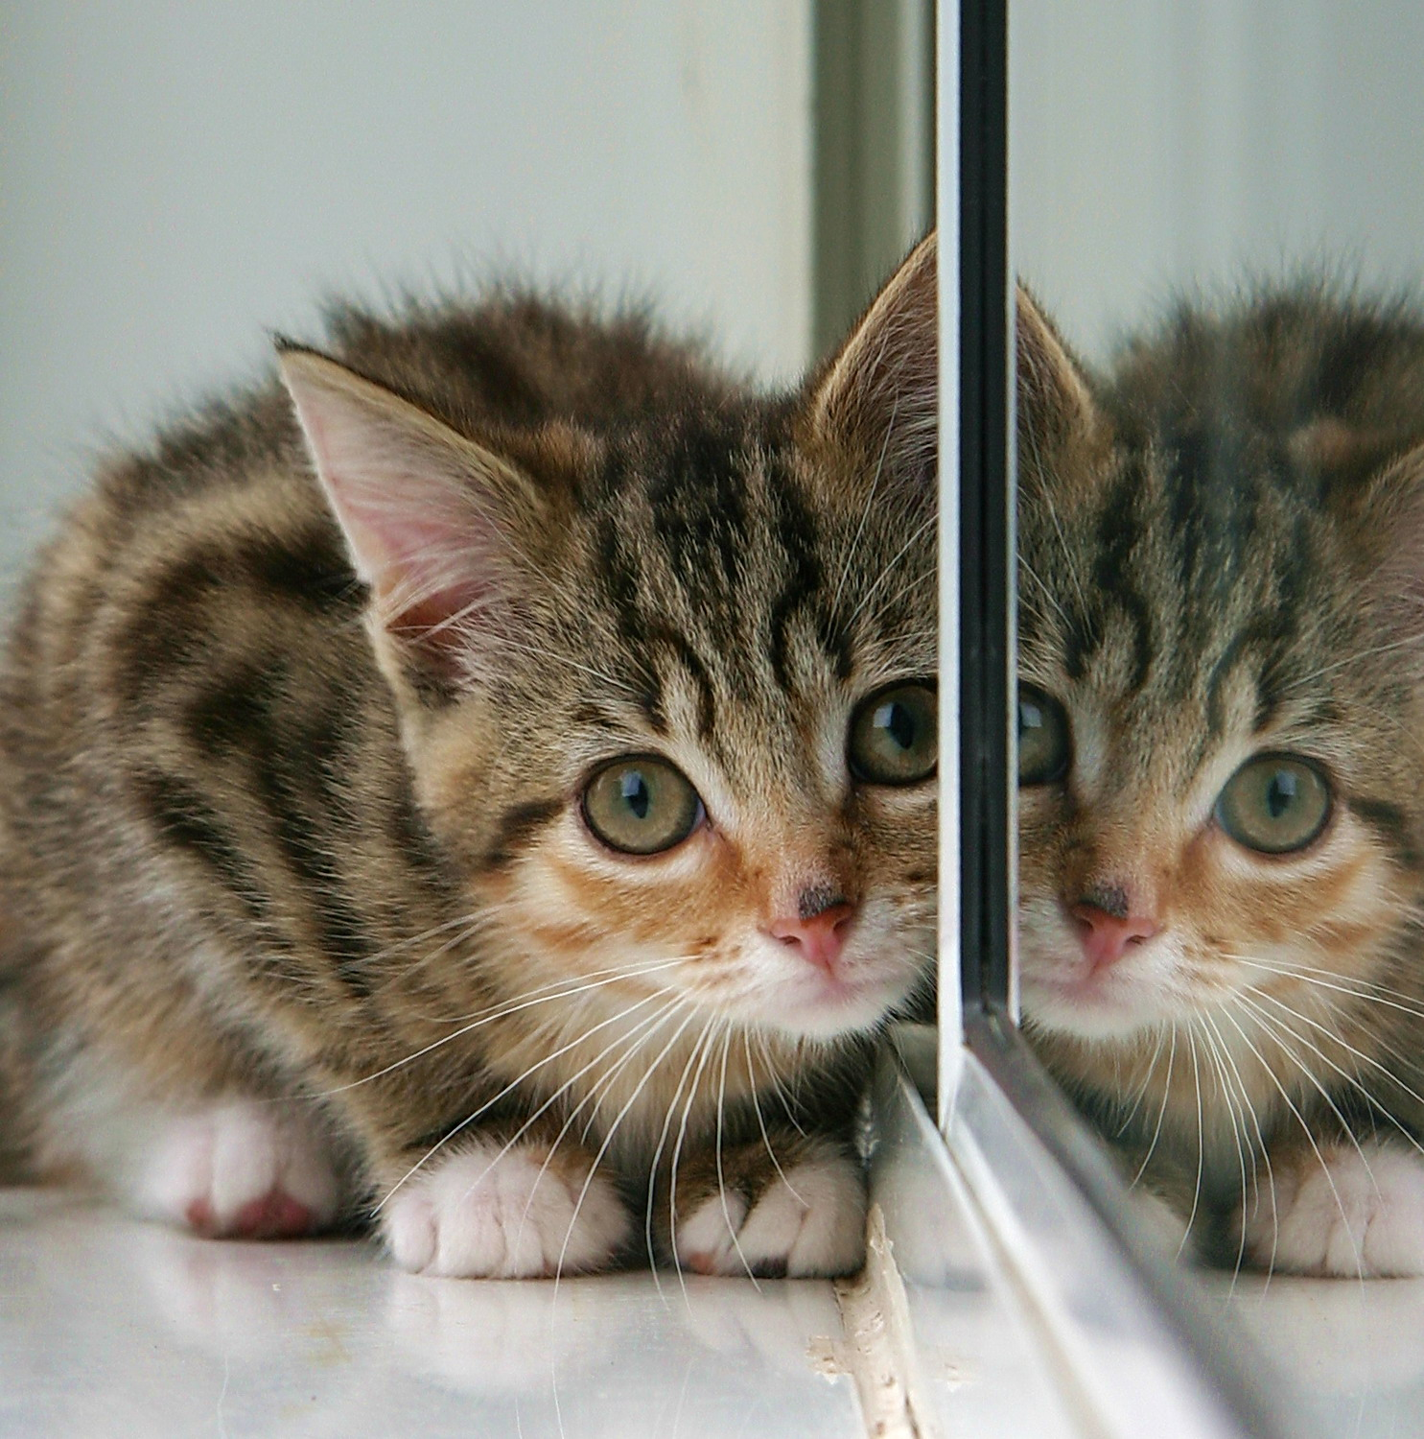
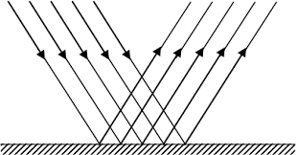
Concept Development
CFU 1
What sort of image is produced by regular reflection?
Regular Reflection
Regular reflection occurs when light reflects off a very smooth surface, such as a window or a mirror.
This produces a clear image.
CFU 2
When does regular reflection occur?

Slide 8
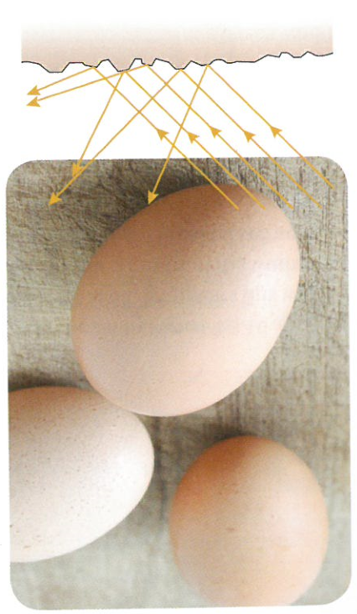
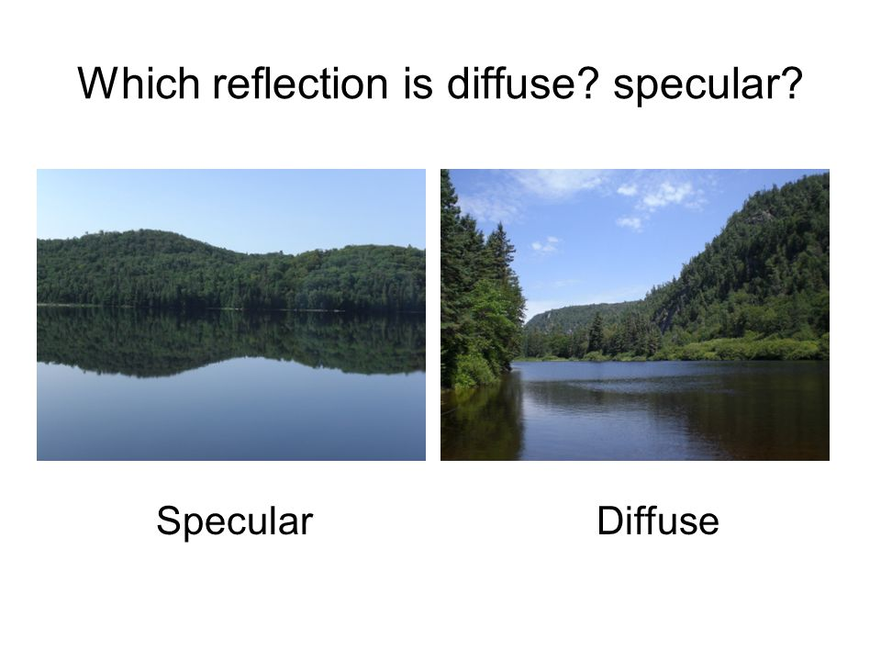
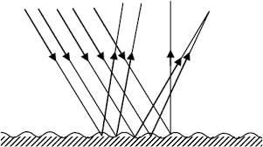
Concept Development
CFU 1
Why do most surfaces not produce an image from reflected light?
Diffuse Reflection
The surfaces of most objects are quite rough when viewed up close.
These surfaces reflect light in many directions and do not form a clear image.
This is referred to as diffuse reflection.
CFU 2
Which image shows diffuse and which shows regular reflection?

Slide 9
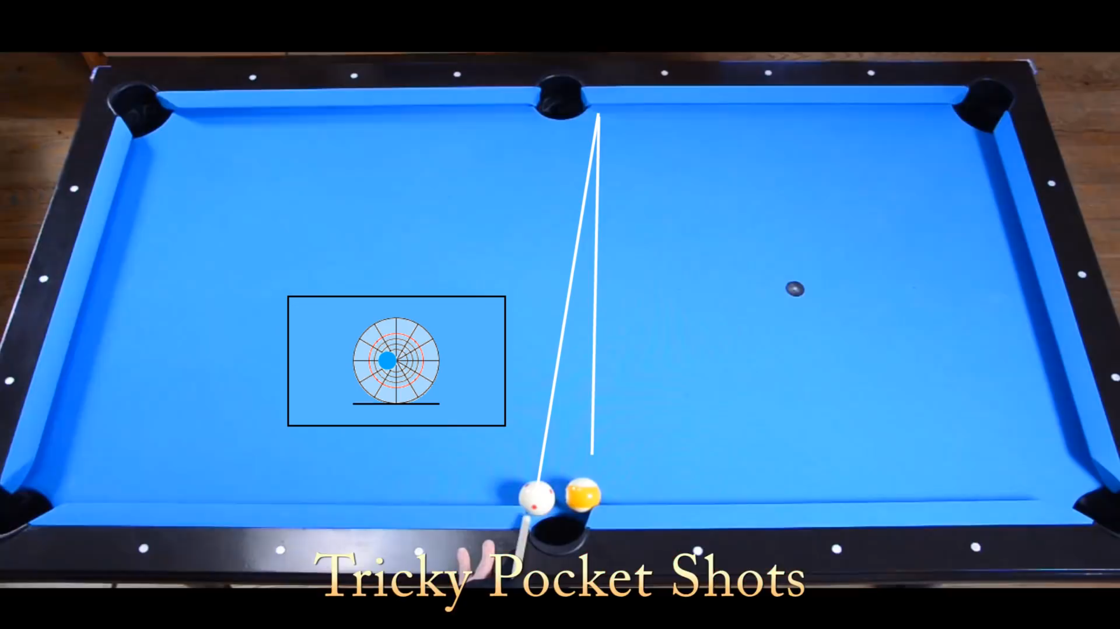
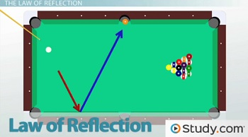
Concept Development
CFU 1
What happens when an object bounces onto a surface at an angle?
The Law of Reflection
When playing pool, if the ball is hit on an angle to the edge of the table, it bounces off at the same angle.
If a ball is hit at right angles to the edge of the table, it will bounce straight back on the same path.
This principle also applies to light.
CFU 2
When will the object bounce straight back on itself?

Slide 10
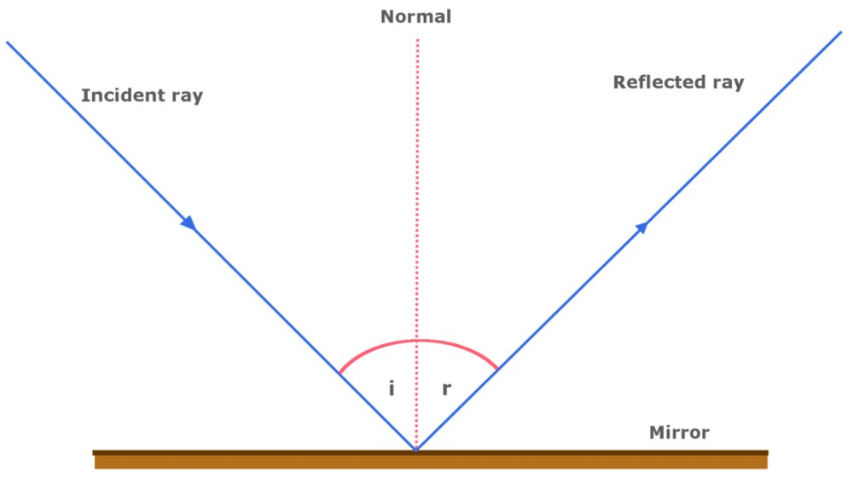
Concept Development
CFU 1
What happens to light rays when they are reflected off a surface?
Law of Reflection
Light always follows particular rules when it reflects off a surface, no matter how smooth or rough the surface is.
When light reflects off a surface, the angle it hits the surface is the same as the angle that it is reflected off the surface.
The normal is an imaginary line drawn at 90° to the mirror’s surface. It is drawn as a dotted line.
This line shows how the light would be
reflected if it is perpendicular to the object.
CFU 2
What is the ‘normal’ and how is it drawn?
CFU 3
What does the normal represent?

Slide 11
Concept Development
CFU 1
What is the incident ray and where does it hit the object?
Law of Reflection
The incident ray is the ray of light that falls on the object.
It hits the mirror or object at the base of the normal.
The angle of incidence is the angle between the incident ray and the normal.
CFU 2
Where is the angle of incidence?

Slide 12
Concept Development
CFU 1
What is the reflected ray and where does it leave the object?
Law of Reflection
The reflected ray is the ray of light that is reflected by the object.
It leaves the mirror or object from the base of the normal.
The angle of reflection is the angle between the reflected ray and the normal.
Arrows are always used to indicate the incident and reflected rays, by showing the direction the light travels.
CFU 2
Where is the angle of reflection?

Slide 13
Concept Development
CFU 1
What is the law of reflection?
Law of Reflection
The law of reflection states that the angle of incidence (symbol ϴ_{i}) is always equal to the angle of reflection (symbol ϴ_{r})
CFU 2
If the angle of incidence in this image is 38°, what is the angle of reflection?

Slide 14
Skill Development/Guided Practice
CFU 1
Which is the incident ray and which is the reflected ray?
Using the Law of Reflection
Label the incident ray (i) and reflected ray (r). Locate or draw the normal and label it (N). Label the angle of incidence (ϴ_{i}) and/or the angle of reflection (ϴ_{r}) Remember the angle of reflection is always equal the angle of incidence.
Draw the diagram on your whiteboard.
CFU 2
Draw and label the normal on your diagram.
CFU 3
Label the missing angle.
N
i
r
ϴ_{i} = 45°
ϴ_{r} = 45°

Slide 15
Skill Development/Guided Practice
CFU 1
Which is the incident ray and which is the reflected ray?
Using the Law of Reflection
Label the incident ray (i) and reflected ray (r). Locate or draw the normal and label it (N). Label the angle of incidence (ϴ_{i}) and/or the angle of reflection (ϴ_{r}) Remember the angle of reflection is always equal the angle of incidence.
Draw the diagram on your whiteboard.
CFU 2
Draw and label the normal on your diagram.
CFU 3
Label the missing angle.
N
i
r
ϴ_{i} = 80°
ϴ_{r} = 80°

Slide 16
Skill Development/Guided Practice
CFU 1
Which is the incident ray and which is the reflected ray?
Using the Law of Reflection
Label the incident ray (i) and reflected ray (r). Locate or draw the normal and label it (N). Label the angle of incidence (ϴ_{i}) and/or the angle of reflection (ϴ_{r}) Remember the angle of reflection is always equal the angle of incidence.
Draw the diagram on your whiteboard.
CFU 2
Draw and label the normal on your diagram.
CFU 3
Label the missing angle.
N
r
i
ϴ_{r} = 75°
ϴ_{i} = 75°

Slide 17
Skill Development/Guided Practice
CFU 1
Which is the incident ray and which is the reflected ray?
Using the Law of Reflection
Label the incident ray (i) and reflected ray (r). Locate or draw the normal and label it (N). Label the angle of incidence (ϴ_{i}) and/or the angle of reflection (ϴ_{r}) Remember the angle of reflection is always equal the angle of incidence.
Draw the diagram on your whiteboard.
CFU 2
Draw and label the normal on your diagram.
CFU 3
Label the missing angles.
N
r
i
ϴ_{r} = 30°
ϴ_{i} = 30°
60°

Slide 18
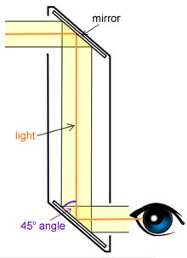
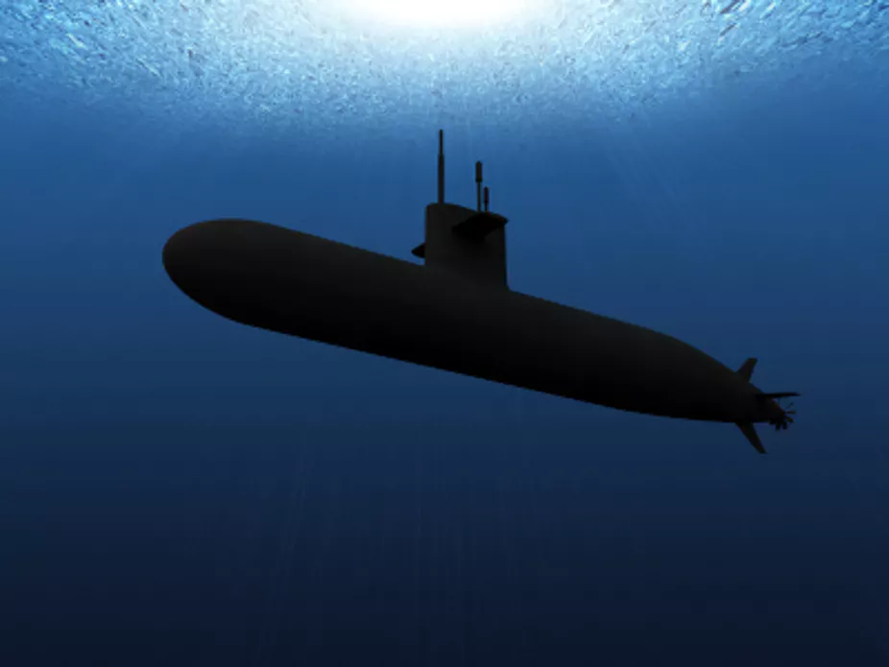
Relevance
Understanding the law of reflection will help you understand how many object, including light, behave when they are reflected off another object.
The law of reflection has many applications:
Allows you to see your reflection in a mirror.
Different configurations of mirrors can be used to see around corners, for example a periscope in a submarine can be used to see what is on the surface.

Slide 19
Skill Closure
Using the Law of Reflection
Label the incident ray (i) and reflected ray (r). Locate or draw the normal and label it (N). Label the angle of incidence (ϴ_{i}) and/or the angle of reflection (ϴ_{r}) Remember the angle of reflection is always equal the angle of incidence.
Explain the difference between diffuse and regular reflection.
Skill Closure
In your own words, describe the law of reflection.
Skill Closure
Draw the diagram on your whiteboard. Label the incident and reflected rays, draw and label the normal, and the angles of incidence and reflection.
40°

Slide 20
Independent Practice
Complete a paper copy of the worksheet on the law of reflection.

